Slide 1
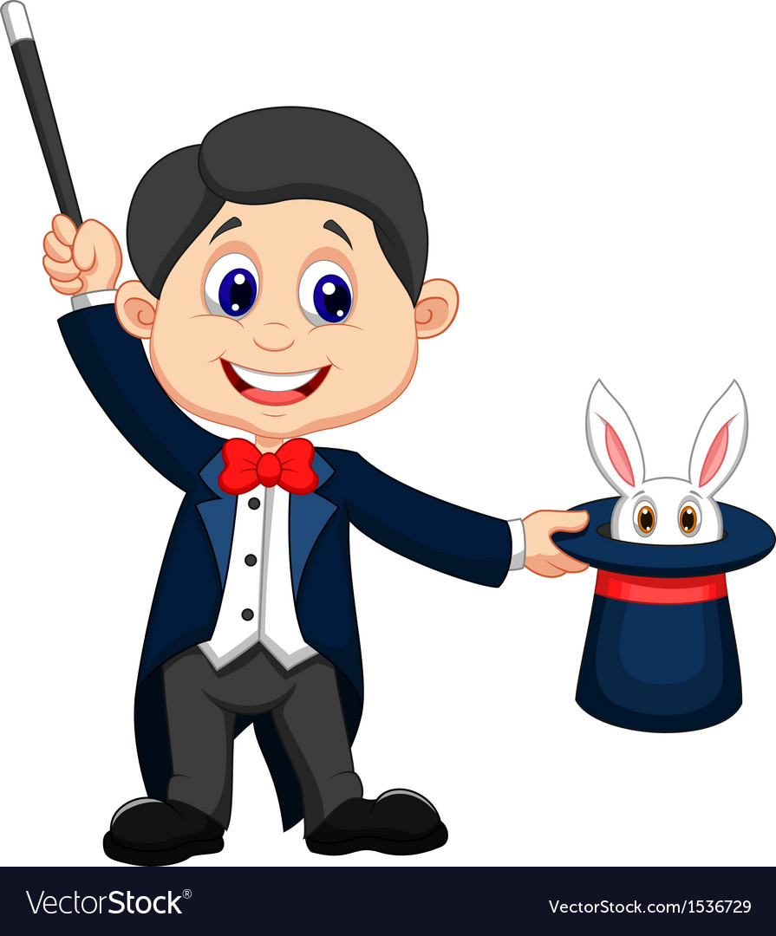
浙江省 Z20 联盟三模 读后续写讲解
A Magician’s secret

Slide 2
捕捉和照应原文
留意细节描写
关注特
定情节
关注高频词
提炼
主题
留意原文结尾
品读
首段
解读续写首句
照应

Slide 3
Para 1 It was time to put an end to the Magic Marty show.
Para 2 “Wait!” Marty jumped in front of me

Slide 4
需要注意的问题：
1.善于用动作链
Marching towards him as fast as I could, I reached out my hand ,grabbed the fishing line and showed it to the classmates triumphantly.
2用肢体动作， 心理描写，脸部表情等增加文章的生动性
Marty was too shocked to move a single inch, the pride glittering/ glistening in his eyes changing into complete astonishment.
At mere sight of his serious face, I felt my heart skipped a beat, fearing I would get a sound blow from him.
3.语言/对话不宜过多
4.紧扣主题的情节发展(向善，making new friends）；延续前文人物性格；前文的协同性
5注意过渡，主位推进法; 主题升华

Slide 5
Paragraph 1：
It was time to put an end to the Magic Marty show. Excited at the thought, I couldn‘t resist crying out, ”It was fishing line!“ Totally surprised at my abruptness, all the classmates including Marty had their attention fixed on me, waiting for an explanation. I pulled out the fishing line to reveal his secrets in front of the classmates. Marty lowered his head with a burning face. Having broken the first law of his proud magic, I was about to stalk off(扬长而去）.

Slide 6
“Wait!” Marty jumped in front of me. With lips trembling, he attempted to say something but in vain and tears were rolling in his eyes. It suddenly occurred to me what magic meant to him. My satisfaction vanished, turning into the shame of jealousy. To Marty, all he had done was merely to befriend more people at school. Out of guilt and regret, I explained my original intention and apologized. Only then did I appreciate never should jealousy gain the upper hand（get the best of me) at any time.

Slide 7
三、结局/结果result/resolution
一系列事件的结束，包括人物的下场，目的的实现或失败
指向部分：
Marty was new at school. Usually when you’re the new kid, you lay low, but not Marty.
品读
首段
(照应）结尾： After the show, Marty was still not a low-key boy but a true super star. He kept performing magic shows for us, with me as his only assistant.

Slide 8
On his first day, he made a toothpick disappear. One second he was holding the toothpick, and the next second it was gone! Everyone was asking him how he did it. “It’s magic! At my old school, they actually called me Magic Marty.” Marty said proudly. “Is he serious?” I whispered to my friend Brian. “ I don't know, but that was pretty cool,”Brian said, still watching Marty. I knew Marty’s magic was fake, but I just couldn’t prove it.
照应（结尾）Marty kept performing magic shows at school. He finally became our “Magic Marty”.
照应（续写第一段) Luckily, the evidence brought the possibility of proving his magic was fake.
关注特
定情节

Slide 9
照应（结尾）：We performed the magic shows together, with applause filling the whole room.
Another time, Marty pulled a water bottle out of his bag, along with a cup and carefully poured water into it. Marty got a handful of ice cubes! Applause filled the hallway. When asked how he did it, he just smiled, “Sorry, but that’s the first law of magic. A magician never reveals his secrets.” Well, he won’t have to, I thought to myself. I’ll reveal his secrets for him. That night, at home, I sat at the kitchen table for almost an hour, trying to figure out the trick. At it again, honey?” My mom watched me wiggle(摆动）my fingers hopelessly over a cup of water. “He’s tricking people!” I cried. “Sounds as if he’s trying to make friends.” My mom patted my arm.
关注高频词
照应（第二段）：（Marty向我解释,echo前文）with determination, he looked into my eyes,” I know you think I’m tricking people. But as a magician, never revealing his secrects is the first law of magic. I just want to bring happiness to others. I...I’m just trying to make friends in this school.” He looked over my shoulders, a strong loneliness enveloping him.
照应（第一段）：（after discovering the secret) ” Cheater! ” Curling my fist angrily, I couldn’t wait to reveal his secrets,

Slide 10
Magic Marty had me stumped (把...难住)，but the next day I caught a lucky break. At lunch, Marty was going on about how he could make things float. He had a ring in one hand and a pencil in the other. That’s when I saw it: a thin piece of fishing line tied around the end of the pencil and attached to a button on Marty’s shirt! Sure enough, he made the ring “float” by sliding it over the pencil and hanging it from the line. No one else noticed, and soon the whole cafeteria was clapping. However, I wasn’t.
照应（续写第一段）I would never missed the lucky break-- I must prove he was tricking everyone. The fishing line was the secret.
照应（续写第一段）Hearing my words, the whole cafeteria was boiling.

Slide 11
捕捉和照应原文
留意细节描写
关注特
定情节
关注高频词
提炼
主题
留意原文结尾
品读
首段
解读续写首句
照应

Slide 12
possible version 1
Paragraph 1：
It was time to put an end to the Magic Marty show. I walked over. “It was fishing line.” I sneered, folding my arms. Marty subconsciously fingered the fishing line and nervously whispered, “So, are you going to tell people?” Seeing the panic in his eyes, somehow, I hesitated. Should I reveal the secret, Marty might lose his new friends. Finally, after struggling for a moment, I replied, “Nah, I won’t say anything.” Marty let out a relieved sigh, and I turned to walk away.

Slide 13
Paragraph 2：
“Wait!” Marty jumped in front of me. Unexpectedly, he patted my arm, grinning, “You’ve got a pretty good eye for magic. Want to join me?” I nodded joyfully. That’s how the Magic Marty and Mysterious Matt Lunch Show began. Now we’ve been a magic team for three months. And since I became a fellow magician, Marty has let me in on (让我参与）some of his other tricks. It turns out that instead of a fake magician, Marty is a real friend.

Slide 14
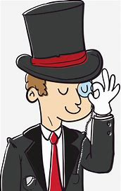
Thank you！

